Slide 1
Efﬁcient Similarity Search : Arbitrary Similarity Measures, Arbitrary Composition
Date: 2011/10/31
Source: Dustin Lange et. al (CIKM’11)
Speaker:Chiang,guang-ting
Advisor: Dr. Koh. Jia-ling

Slide 2
Index
Introduction
Problem Definition
Evaluating Query Plans
Query Plan Optimization
Evaluation
Conclusion

Slide 3
Introduction
Many commercial applications maintain a person/customer data set that typically contains information such as the name, the date of birth, and the address of individuals that are somehow related to the company.
Searching require:
answered extremely fast.
answered result that might be relevent with query.

Slide 4
Introduction
Motivation:
For these and similar problem settings, a common approach is to deﬁne several similarity measures for diﬀerent aspects of the problem.
Goal:
To combine such similarity measures, there exist diﬀerent approaches.
perform eﬃcient search based on a set of similarity measures and an arbitrary composition technique.

Slide 5
Filter-and-refine Search
Introduction
Database
query
result
Database
Data base
1.Contain correct similar record
2.Missing data should be as low
as possible
3.List should be as low as
possible
Filter criterion
Query plan

Slide 6
Problem Definition
Composed similarity measures
Query plan optimization

Slide 7
Composed similarity measures
Problem Definition
FirstName | LastName | Birthdate | zip
[0,1]
$${Sim}_{FirstName}$$
$${Sim}_{LastName}$$
$${Sim}_{Birthdate}$$
$${Sim}_{zip}$$
Jarco-winkler distance | Jarco-winkler distance | Relative distance | Numeric difference
Weighted sum
$${Sim}_{overall}$$

Slide 8
Query plan optimization
Problem Definition
$${Sim}_{p}(q,r)≥φ_{p}$$
$$p≥φ_{p}$$
Query plan template: a combination of attribute predicates with the logical operators
conjunction and disjunction.
Query plan : all threshold variables in a query plan template are
assigned a value.
Example :
Query plan template
( FirstName ≥ $φ_{\text{FirstName}}$ ∧ Zip ≥ $φ_{\text{Zip}}$ ) ∨ ( LastName ≥ $φ_{\text{LastName}}$
∧ BirthDate ≥ $φ_{\text{BirthDate}}$)
Query plan: ( FirstName ≥ 0.9 ∧ Zip ≥ 1.0 ) ∨ ( LastName ≥ 0.8 ∧ BirthDate ≥ 0.85 )

Slide 9
Problem Definition
Query plan optimization
To evaluate query plans, we deﬁne diﬀerent performance metrics.
completeness comp(qp) :
a query plan qp is the expected proportion of correct query/result record pairs that are covered by qp.
costs costs(qp) :
a query plan qp is the expected average number of records in R that are covered by qp.
Given a set R of records and a cost threshold C, the query plan optimization problem is to ﬁnd the query plan qp that maximizes comp(qp) with costs(qp) < C.

Slide 10
Evaluating Query Plans
Completeness Estimation
How many matches can be found with this query plan?
Cost Estimation
How large is the cardinality of an average query result with this query plan?

Slide 11
Completeness Estimation
Evaluating Query Plans
Gathering Training Data :
Real Training Data:
In our use case, we have a set of 2m queries, most of them with results manually labeled as correct. This is the ideal situation, where we can rely on a manually labeled set of query/result record pairs.

Slide 12
Completeness Estimation
Evaluating Query Plans
Estimation
T : training instance
${covers}_{qp}\left(q, r\right)$ evaluates to true iﬀ the pair (q, r) is covered by qp (i. e., if the query plan predicates are fulﬁlld).

Slide 13
Completeness Estimation
Evaluating Query Plans
Estimation
Basic algorithm:
Iterate over the list T and count all query/result record pairs that
are covered by qp.
Speed up the basic algorithm:
For each distinct base similarity value combination, we save its
count, thus eliminating all “duplicate” combinations.
Reduce the number of value combinations by rounding to two decimal places.
Reduce the amount of value combinations to be checked from 2.0m to 4.4k (a reduction rate of 99.8 %).

Slide 14
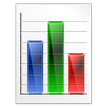
Cost Estimation
Evaluating Query Plans
Naïve:
Costly task
Propose:
Quickly

Slide 15
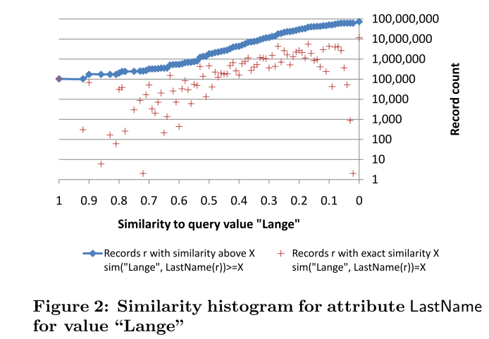
Cost Estimation
Evaluating Query Plans
Similarity histograms
For each analyzed value, we calculate the similarity to all other values of the attribute.

Slide 16
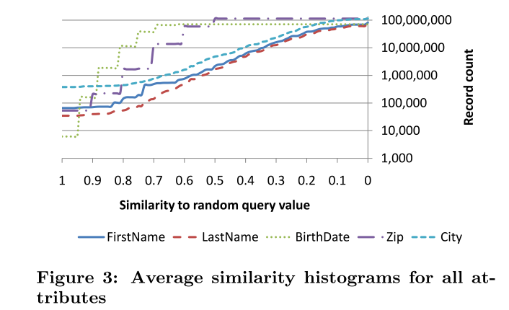
Cost Estimation
Evaluating Query Plans
Similarity histograms
For each possible similarity, averag the measured numbers of records with similar values.

Slide 17
Cost Estimation
Evaluating Query Plans
Combining attribute estimations
We multiply the probability with the cardinality of the complete record set to determine expected average costs:
$cost\left(qp\right)=|R|∗P({covers}_{qp}\left(q,r\right)|q∈U, r∈R )$
U: universe set $R$: a subset of U
an attribute predicate p ≥ $φ_{p}$ in $P({covers}_{p\text{≥}φ_{p}}\left(q,r\right)|q∈U, r∈R )$ abbreviate as $P(p\text{≥}φ_{p} )$.
Example: LastName ≥ 0.9 ∧ City ≥ 0.95

Slide 18
Cost Estimation
Evaluating Query Plans
Example: ( (A ∧ B) ∨ (C ∧ D) ∨ (E ∧ F ) )
P ( A ≥ ${\text{φ}}_{A}$ ∧ B ≥ ${\text{φ}}_{B}$ )

Slide 19
Cost Estimation
Evaluating Query Plans
Example: ( (A ∧ B) ∨ (C ∧ D) ∨ (E ∧ F ) )
P (A ≥ ${\text{φ}}_{A}$ ∨ B ≥ ${\text{φ}}_{B}$ )
P (A ≥ ${\text{φ}}_{A}$ ∨ B ≥ ${\text{φ}}_{B}$ ∨ C ≥ ${\text{φ}}_{C}$ )
=P (A ≥ ${\text{φ}}_{A}$ ) + P (B ≥ ${\text{φ}}_{B}$ ) + P (C ≥ ${\text{φ}}_{C}$ )- P (A ≥ ${\text{φ}}_{A}$ ∧ B ≥ ${\text{φ}}_{B}$ )
- P (A ≥ ${\text{φ}}_{A}$ ∧ C ≥ ${\text{φ}}_{C}$ ) - P (B ≥ ${\text{φ}}_{B}$ ∧ C ≥ ${\text{φ}}_{C}$ )
+ P (A ≥ ${\text{φ}}_{A}$ ∧ B ≥ ${\text{φ}}_{B}$ ∧ C ≥ ${\text{φ}}_{C}$ )

Slide 20
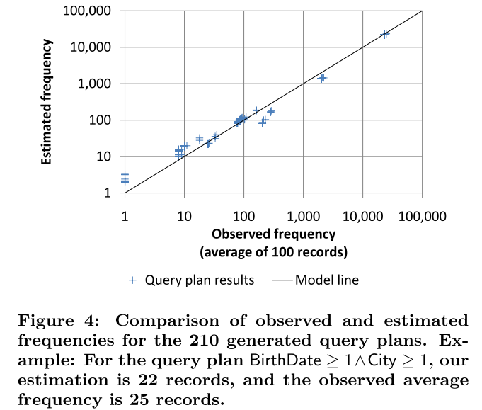
Cost Estimation
Evaluating Query Plans

Slide 21
Query Plan Optimization
Best query plan, i. e., the plan with highest completeness below a cost threshold.
How??
Iterate over the set of all possible query templates and then optimize thresholds for each query plan template.
Then,got a optimal query plan per query plan template.
From these query plans, can simply select the overall best query plan.
Cost too much.

Slide 22
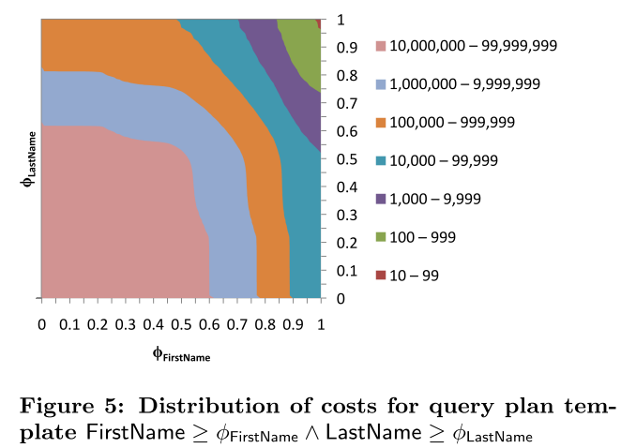
Query Plan Optimization
Observations-cost

Slide 23
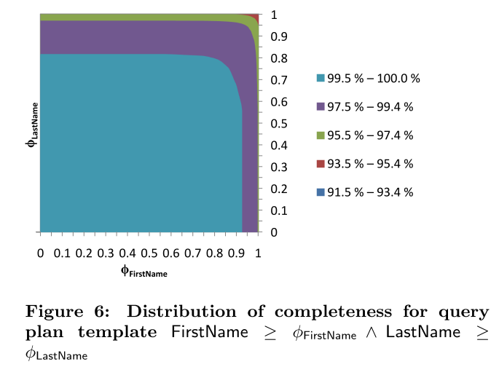
Query Plan Optimization
Observations-completeness

Slide 24
Query Plan Optimization
Top neighborhood algorithm
The algorithm should only evaluate as few query plans as possible and determine an overall good solution.
1
1
A
C
0
1
0
1
1
B
D
 | ………. | W(q6) | W(q4) | W(q1)
 |  | ………. | W(q5) | W(q2)
 |  | W(q10) | ……… | W(q3)
 |  |  |  | ……..
W(qn) |  |  |  | ……..
(A ∧ B) ∨ (C ∧ D)
0
1

Slide 25
Query Plan Optimization
1
1
Ex: by 0.01
A
C
0
1
0
1
B
D
(A ∧ B) ∨ (C ∧ D)
A query plan qp has a neighborhood
N(qp) that contains all query plans that can be constructed by lowering one thresholds of qp by one step

Slide 26
Query Plan Optimization
1
1
Window W = {q1 . . . qn }.
Top t neighborhood $T_{t}(W)$.
The cost threshold C also determines the stopping criterion of our algorithm.
A
C
0
1
0
1
B
D
(A ∧ B) ∨ (C ∧ D)
$$\text{φ}\text{=0.6}$$
1
 | ………. | N(W6) | N(W4) | N(W1)
 |  | ………. | N(W5) | N(W2)
 |  | N(W10) | ……… | N(W3)
 |  |  |  | ……..
N(Wm) |  |  |  | ……..
0
1

Slide 27
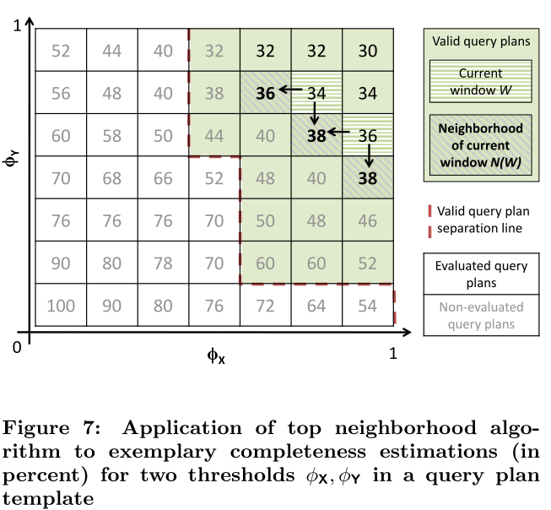
Query Plan Optimization

Slide 28
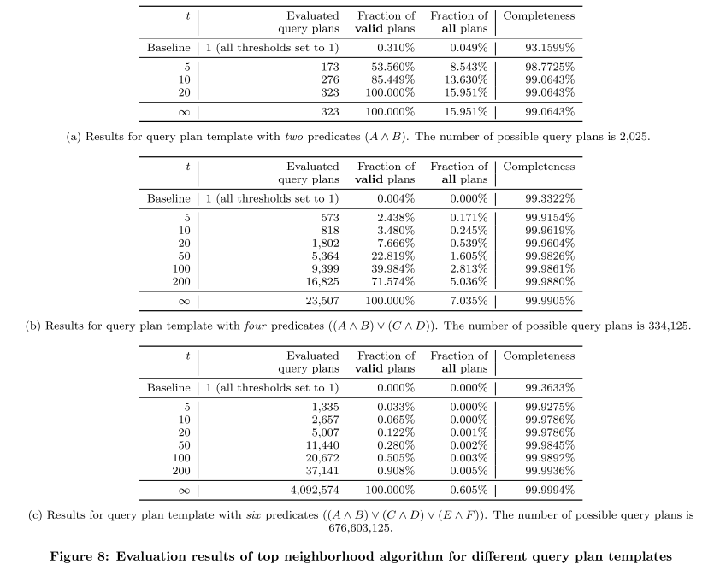

Slide 29
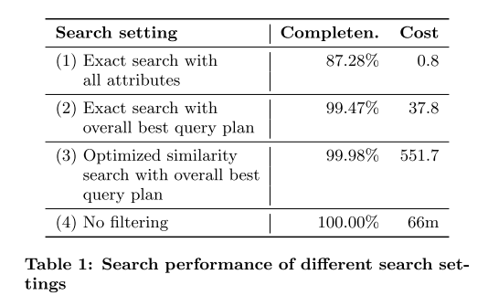
Real-world Similarity Search
210 query plan templates
t = 100 (a window size that results in acceptable runtime of our algorithm)
C = 1000 (a cost threshold that is acceptable for our use case).
Randomly selected 50,000 queries from our test data set.

Slide 30
Conclusion
Introduced a novel approach to eﬃcient similarity search for composed similarity measures.
Showed how to eﬃciently compute completeness and costs, two important performance metrics for query plans based on a set of similarity indexes.
The resulting trade-oﬀ between completeness and costs has been solved with the approximative top neighborhood algorithm.
Showed that the algorithm eﬃciently determines near-optimal query plans for real-world data.

Slide 31
Thx for your listening …..

Slide 32
Speed up the basic algorithm
Amount | FirstName | LastName | Birthdate | zip
12345 | EDDY | MA | 1/1 | 890
22678 | JACK | JOHNSON | 2/13 | 888
1423665 | KOBE | CHU | 7/7 | 235
158489 | JACK | JOHNSON | 2/13 | 888
9527 | JACK | JOHNSON | 2/13 | 888
Query plan: (FirstName ≥ 0.8) Query : Jackson Mark
Susan
Jackson
Maggie
3
delete

